Slide 1
SHOE HEAVEN
Nevena Pavlova
Yavor Karakolev
Iliya Marinov
Radoslav Ivanov

Slide 2

The main idea

Slide 3
The process
We considered the idea about our project!
We made a decision about the idea "Shoe shop".
We have allocated the tasks.
We have set a deadline for completing the tasks.
Final changes to the code.

Slide 4

Other functions are also:
Make order
Edit order
View cart
Sign up

Slide 5
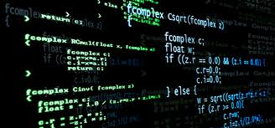
And now it's time for our program

Slide 6


Slide 7
THANK YOU FOR THE ATTENTION!
NSPavlova18@codingburgas.bg
YAKarakolev18@codingburgas.bg
IMMarinov18@codingburgas.bg
RIIvanov@codingburgas.bg

